Slide 1
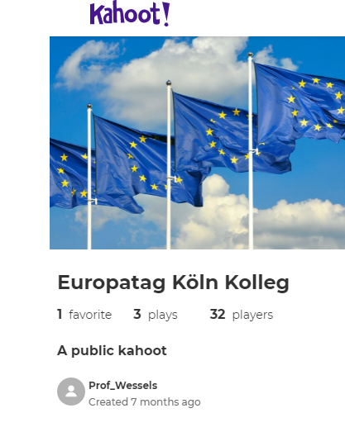
Please find the Quiz here:
https://create.kahoot.it/share/europatag-koln-kolleg/a58dadf1-d782-4e33-b5fc-85a9f76c8343

Slide 2
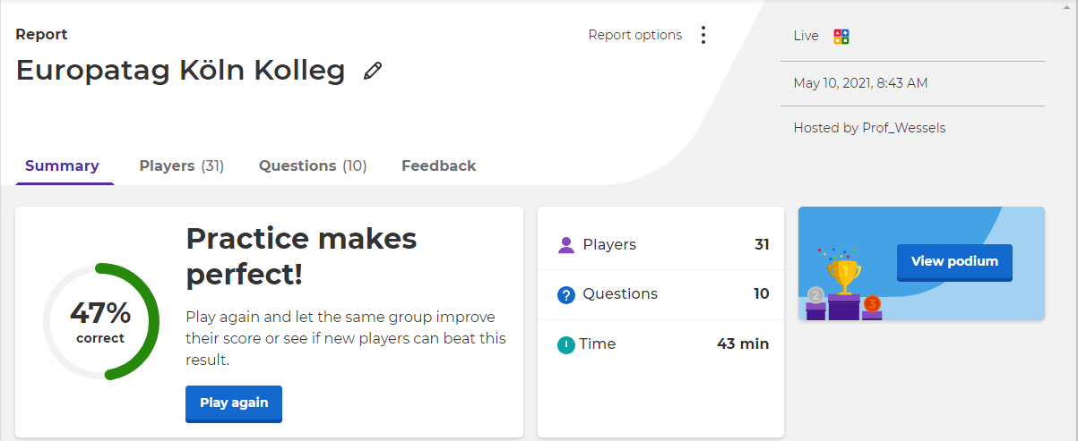

Slide 3
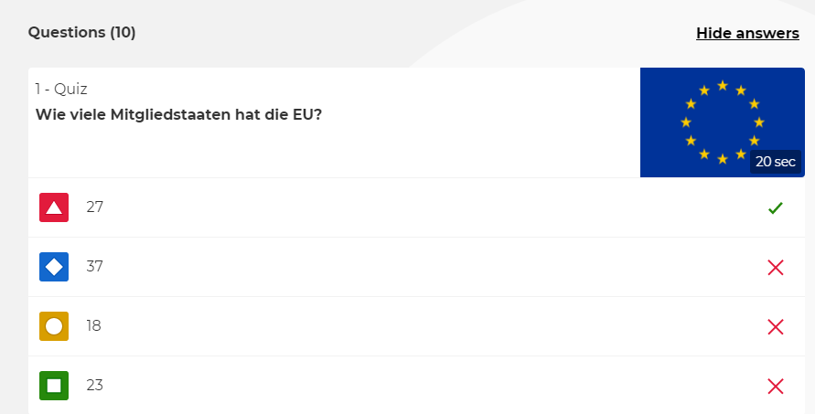

Slide 4
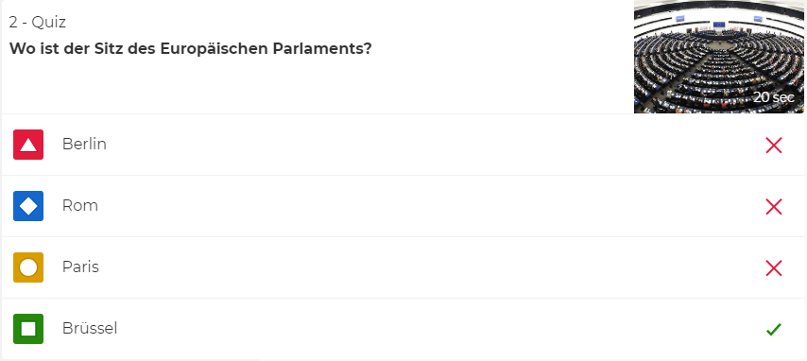

Slide 8
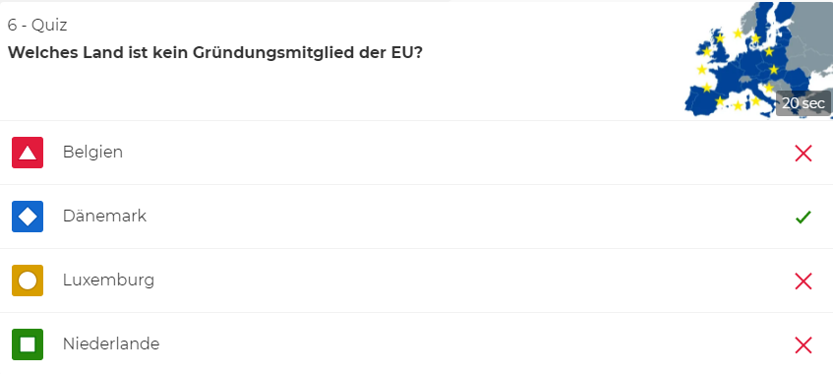

Slide 9
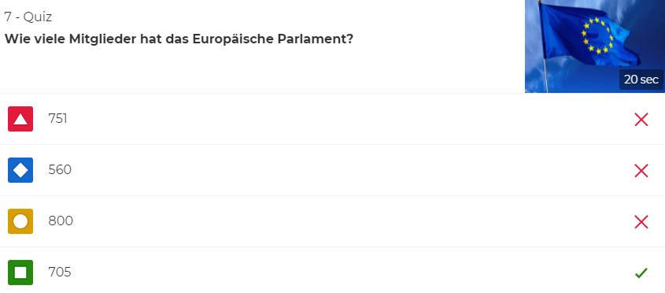

Slide 11
